Slide 1


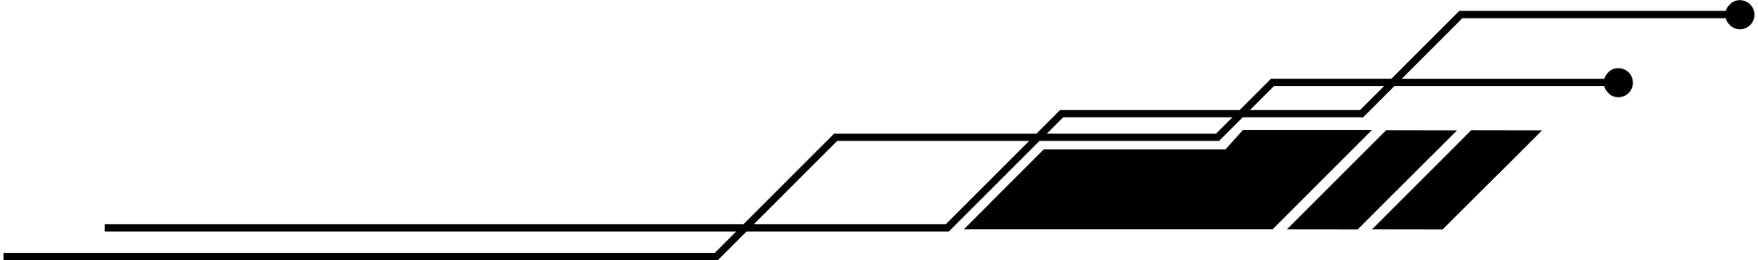
Armando Bufacch: ST10092068
Corne’ Ackerman: ST10092070
Nomaswazi Sibeko: ST10246300
Ryan Blignaut: ST10092012
PRESENTS TO YOU:
RainFall
Mobile App

Slide 2
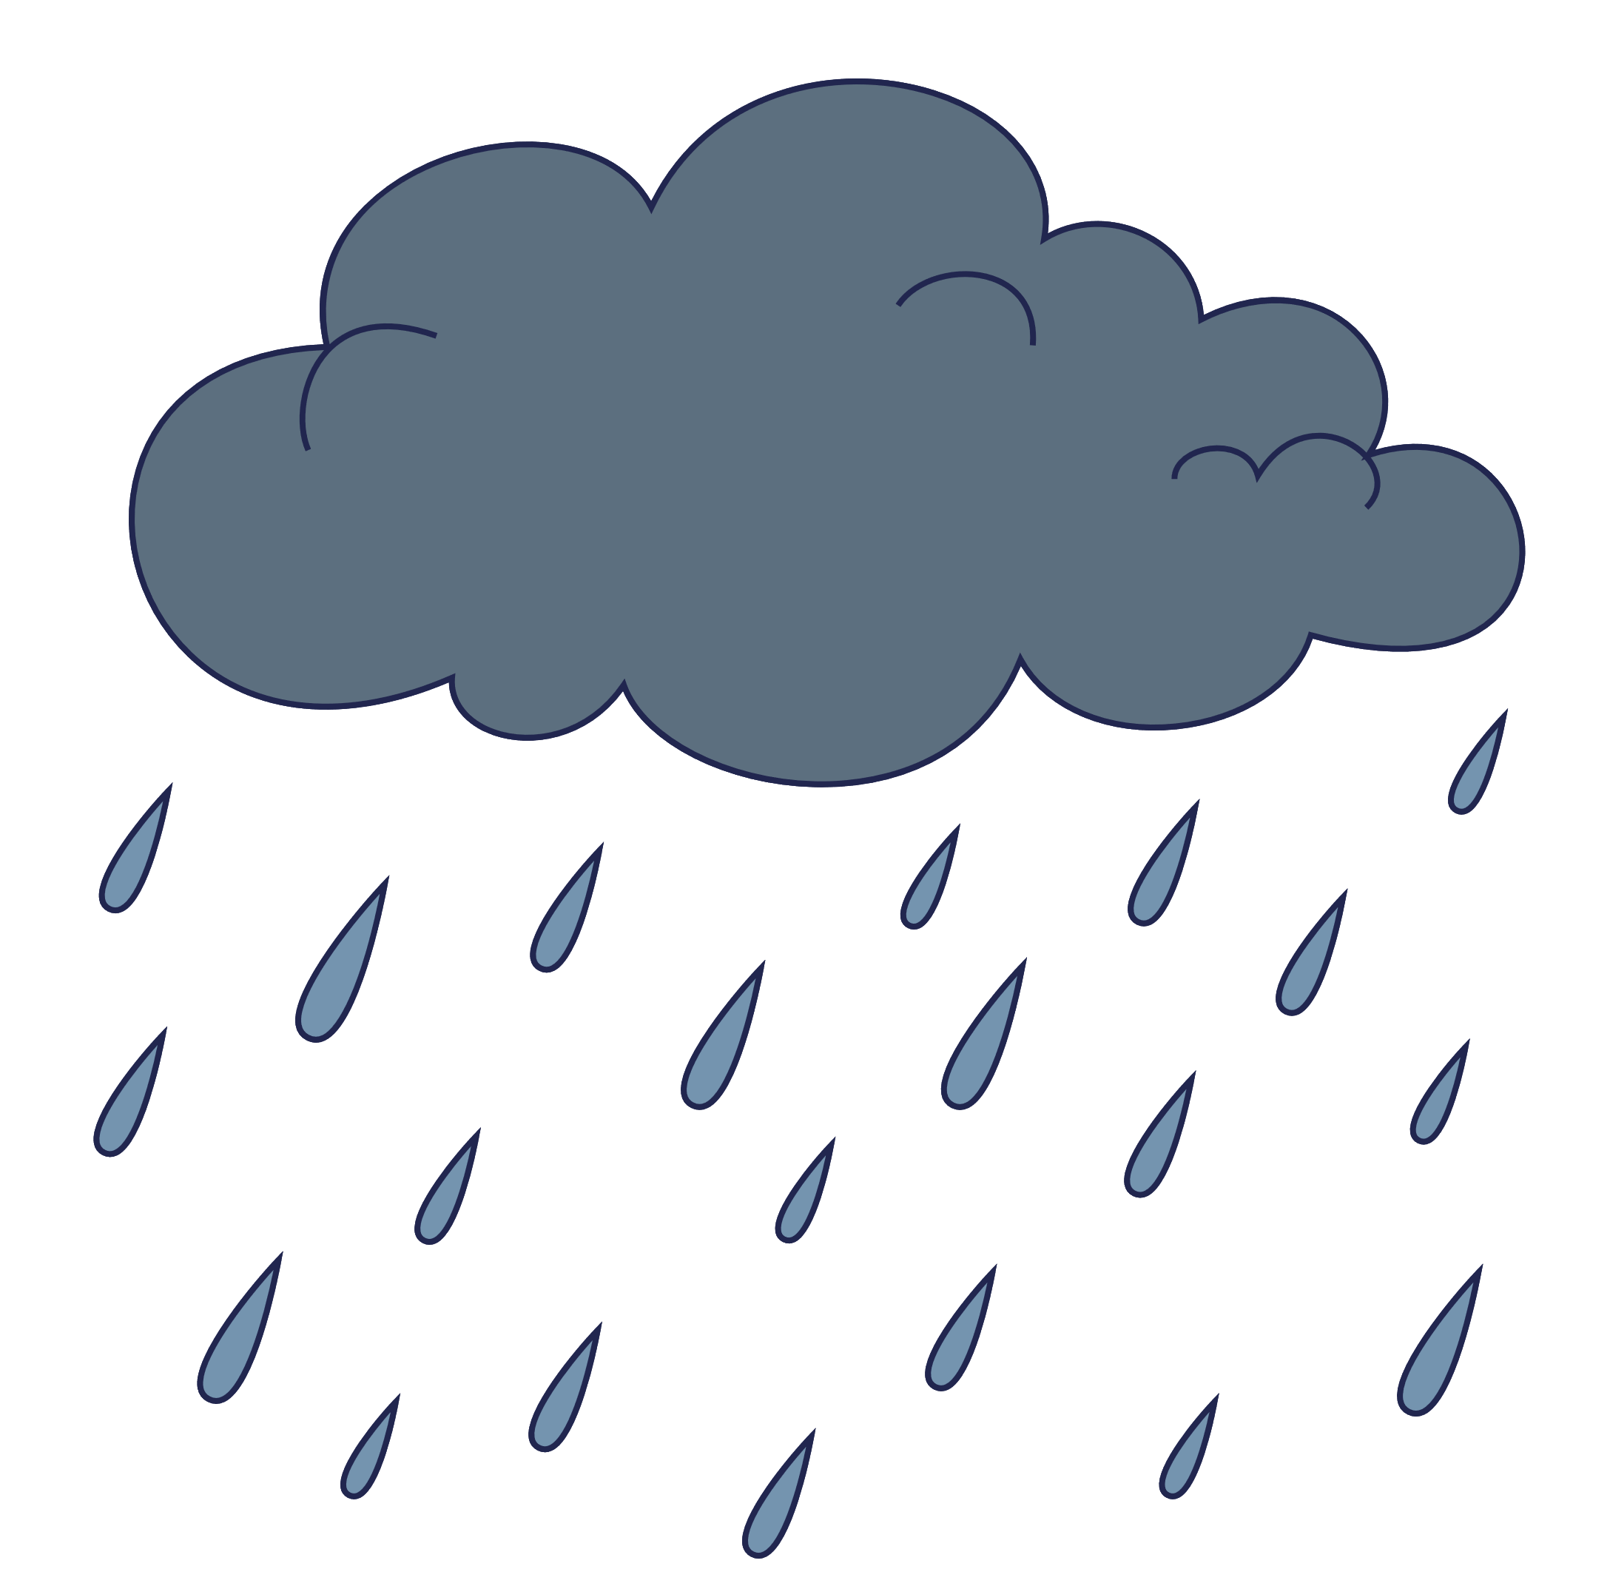
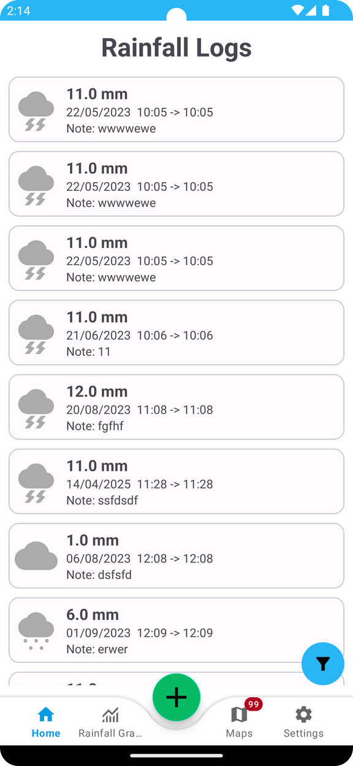


INTRODUCTION
Introducing RainFall, a comprehensive weather tracking application designed to meet your needs. RainFall allows you to log rainfall data efficiently, including mm measurements, dates, and customizable time frames, all while accommodating multiple logging locations.

Slide 3
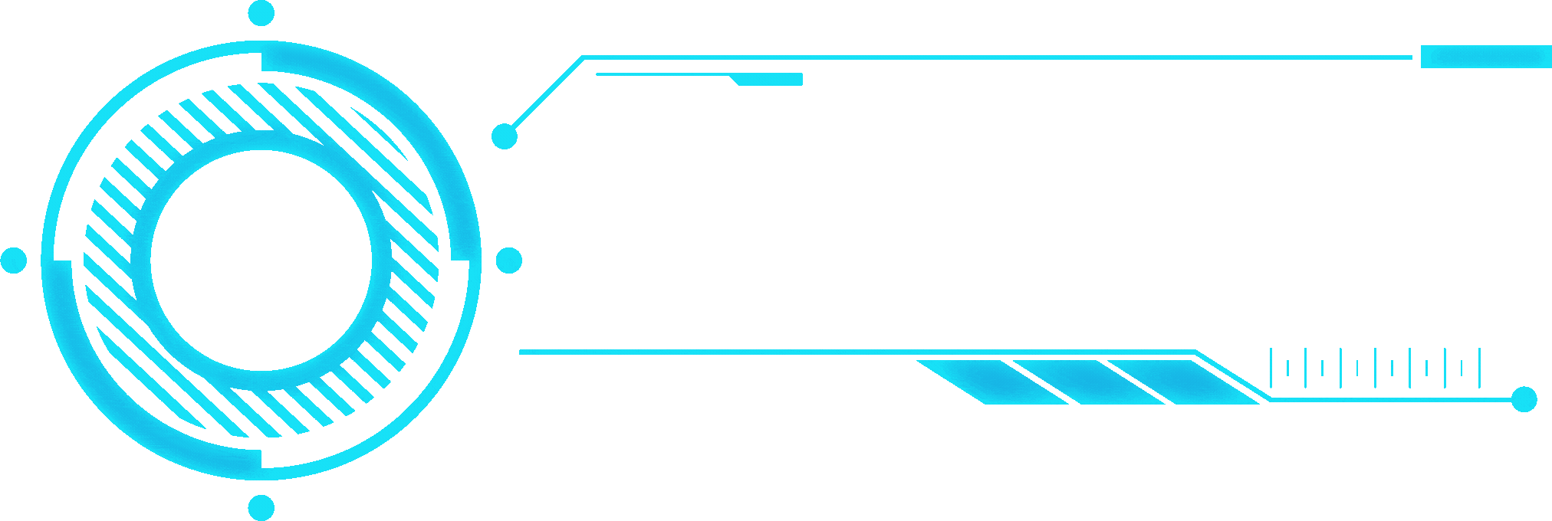
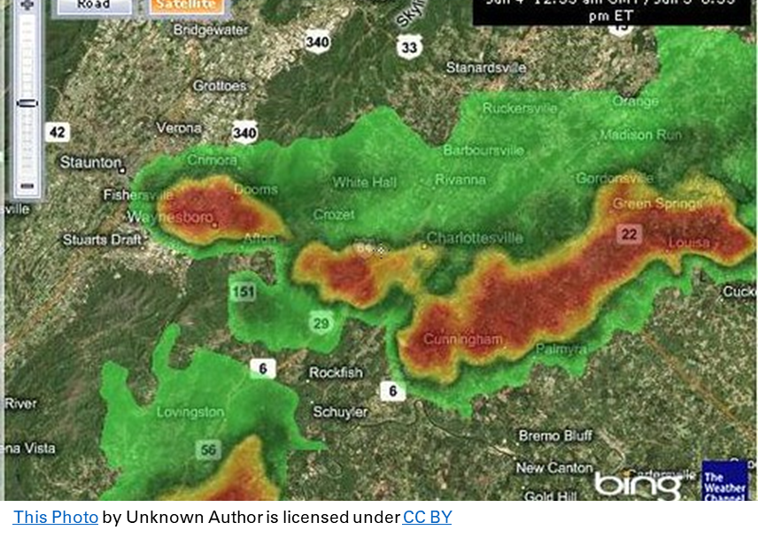
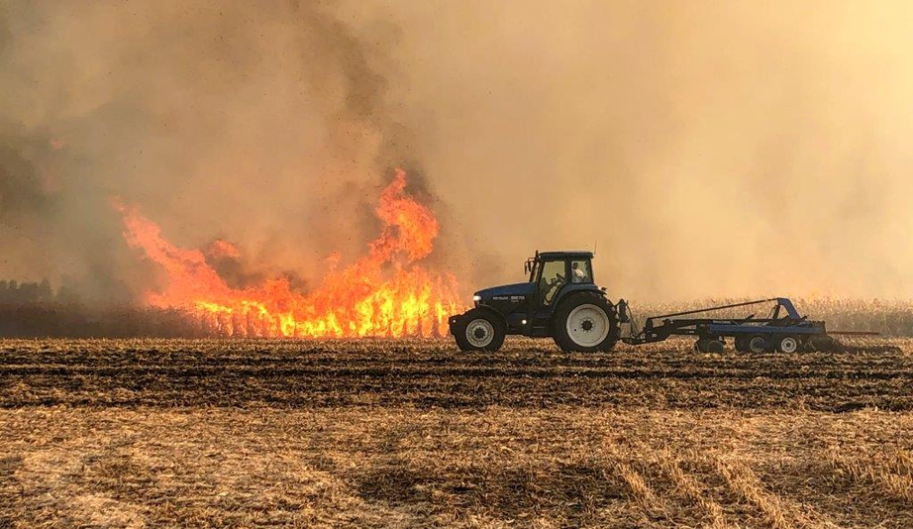
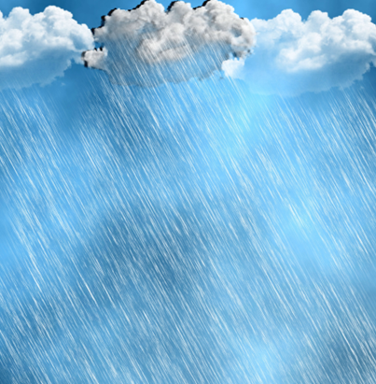
WHAT TO EXPECT?
Our app for ‘Plant
Bietjie ’ will include three main features:
Rain Logging
Fire Risk Notifications,
Weather Information.
Additional features will include
Data Backups,
sharing,
Fire Risk Info and Map,
Weather risks, and a Weather Map.

Slide 4
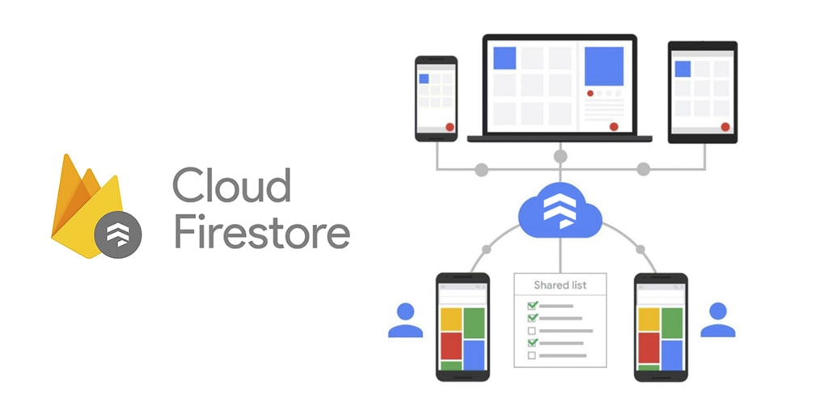


TECHNICAL ARCHITECTURE
The RainFall application is built on a robust technical architecture utilizing Google Cloud Firestore for seamless Android integration, scalability, and real-time data synchronization. Meteorological data is sourced from OpenWeatherMap and WeatherAPI

Slide 5

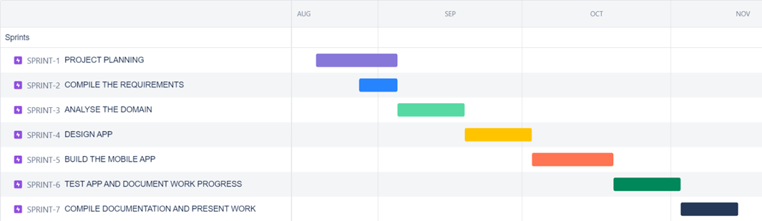

ROADMAP
This roadmap defines our goal or desired outcome and includes the major sprints or milestones needed to reach it. It is a high-level document that helps articulate strategic thinking behind both the goal and the plan for getting there.

Slide 6
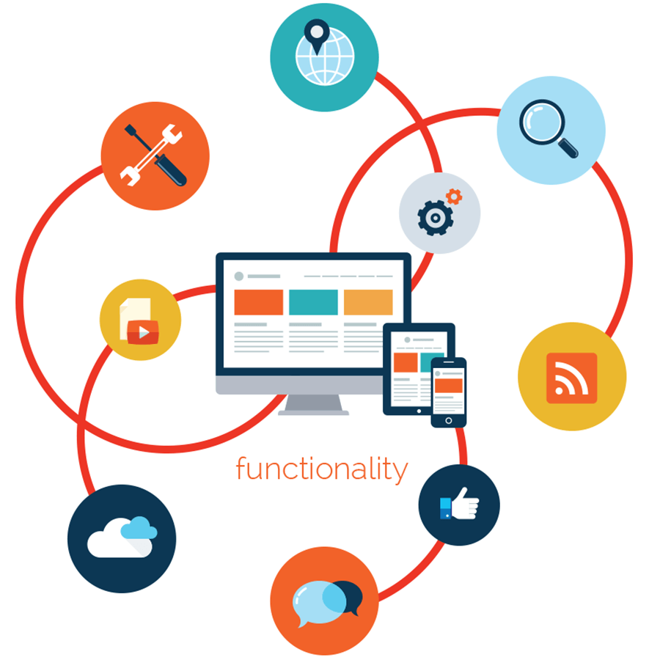
USER REQUIREMENTS
Regular User:
This user role is the general user of the app, they will only want to use the basic features of the app, such as logging rainfall and sometimes viewing local weather.
Farmer User:
This user role represents users who are primarily in more rural areas, that need additional features related to the area they live in, primarily fire risks and viewing cloud coverage data.

Slide 7

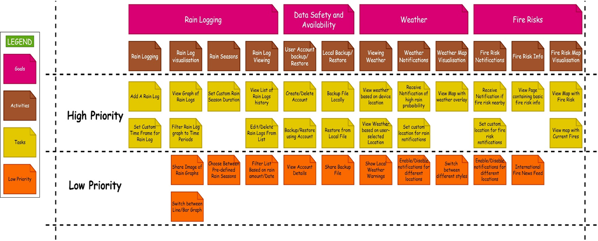
USER STORY
This user story provides a user-focused framework for daily work — which drives collaboration, creativity, and a better product overall

Slide 8
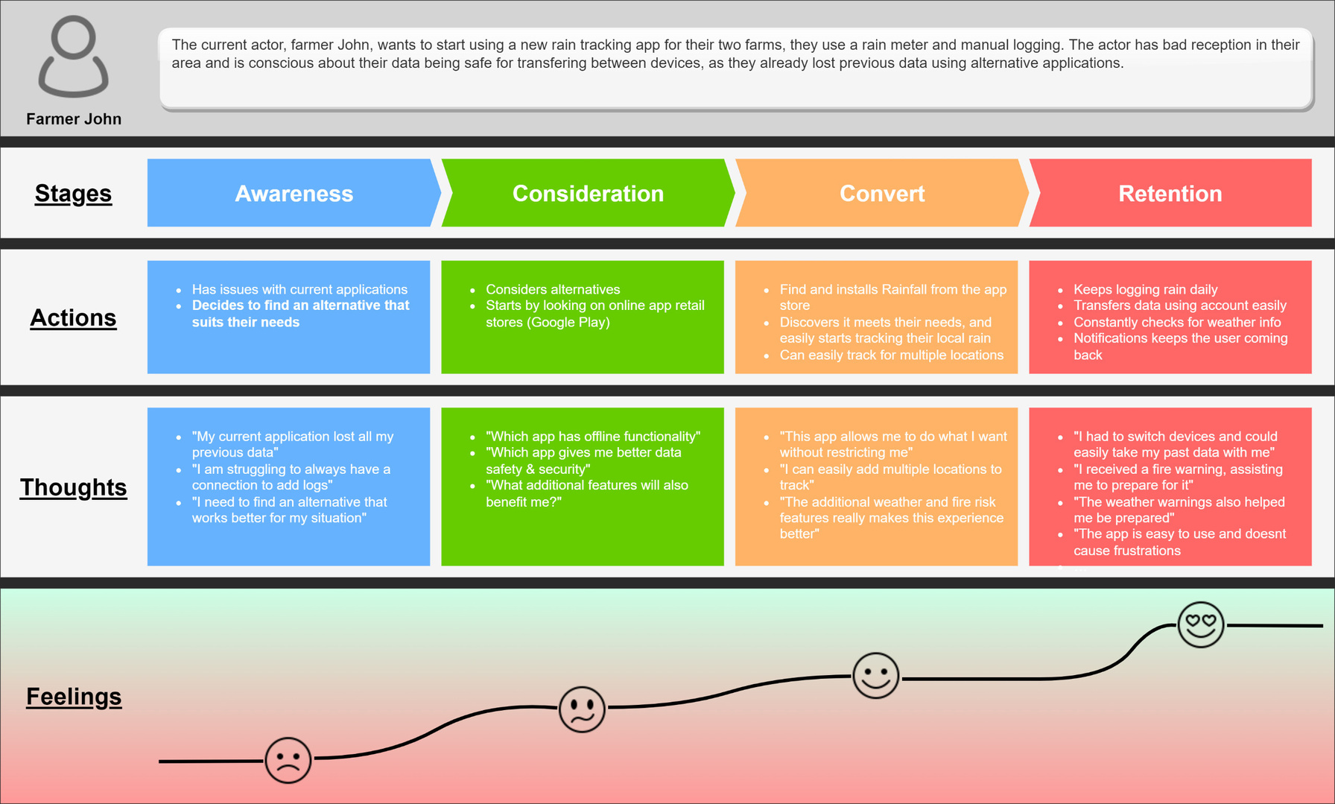

USER EXPERIENCE
The goal of UX design is to create easy, efficient, relevant, and all-around pleasant experiences for the user.

Slide 9
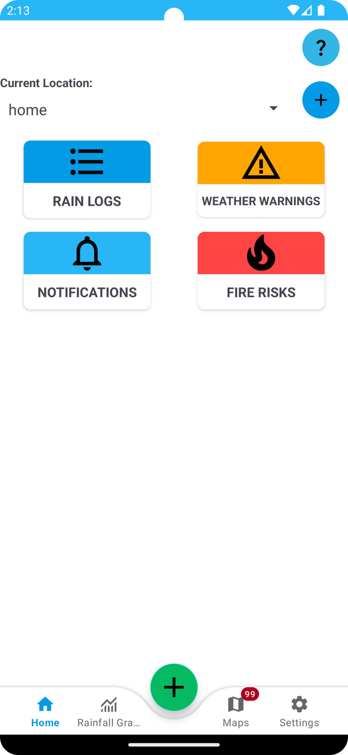
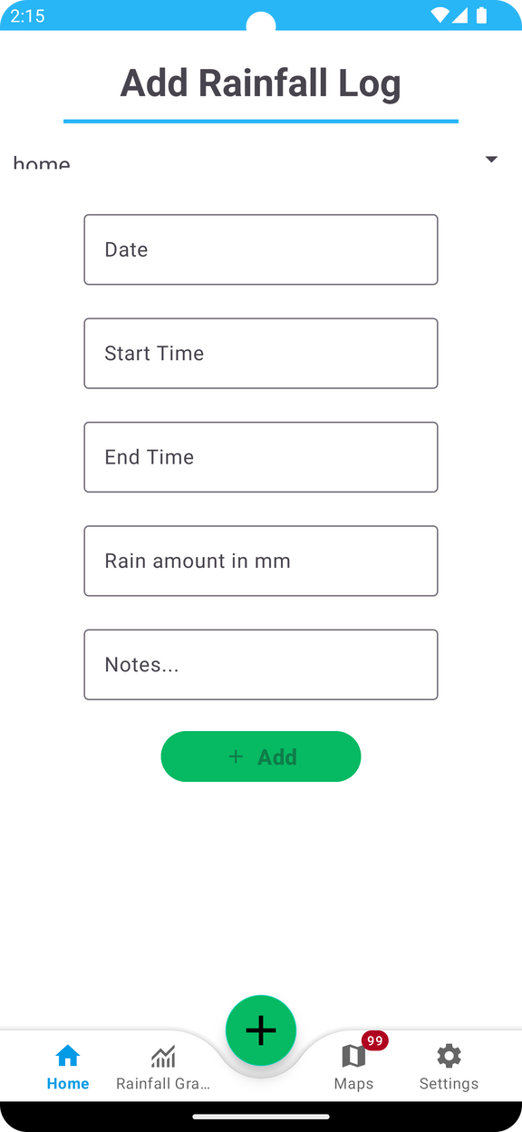
RainFall’s
Quick Features
Rainfall Log Screen
The Homescreen has specific feature tabs within which will allow the user to navigate to their desired feature.
In this Rainfall Log Screen, the user is able to log the amount of rain, along with the date and time frame, so that they can track rainfall in their area.
Homescreen

Slide 10
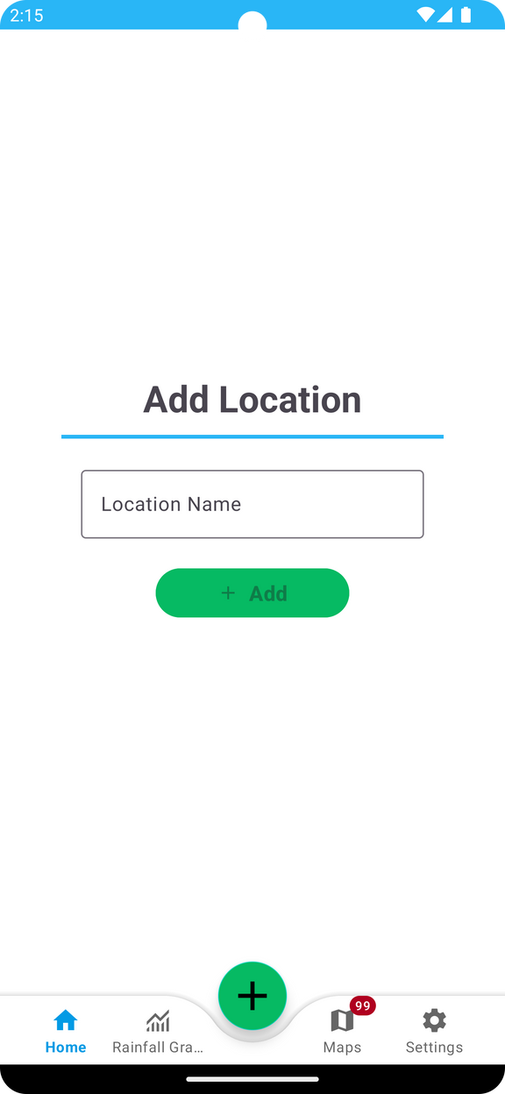
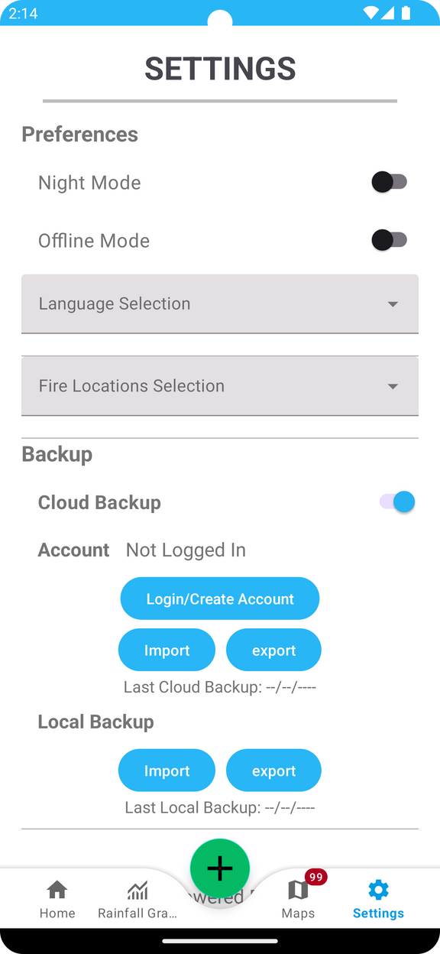
SettingsScreen
The settings screen allows the user to toggle between their preferred user mode, language selection, fire location selection and backing up of data.
The location screen allows the user to add their desired location to receive notifications based upon that specific location.
Add Location screen

Slide 11
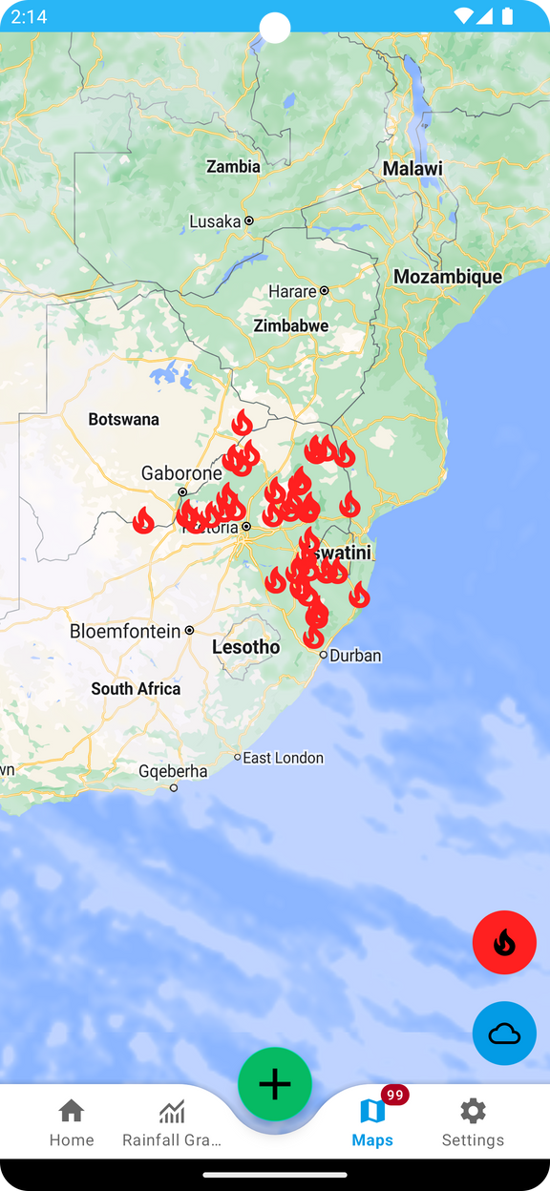
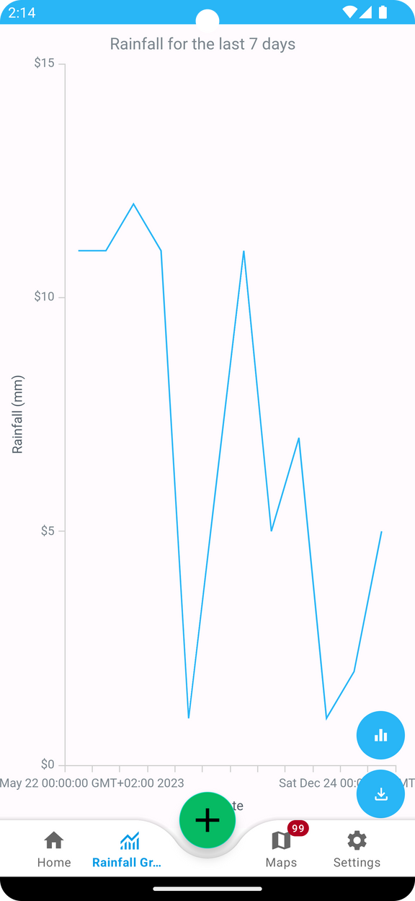
RainFall Graph
Screen
The WeatherMap screen has red fire icons scattered across the country as to alert users of possible fire risks.
While the rainfall graph screen displays rainfall for the last 7 days. The app has a line graph with a blue line, where the x-axis is labeled with dates and the y-axis is labeled with rainfall in millimeters.
WeatherMap Screen

Slide 12
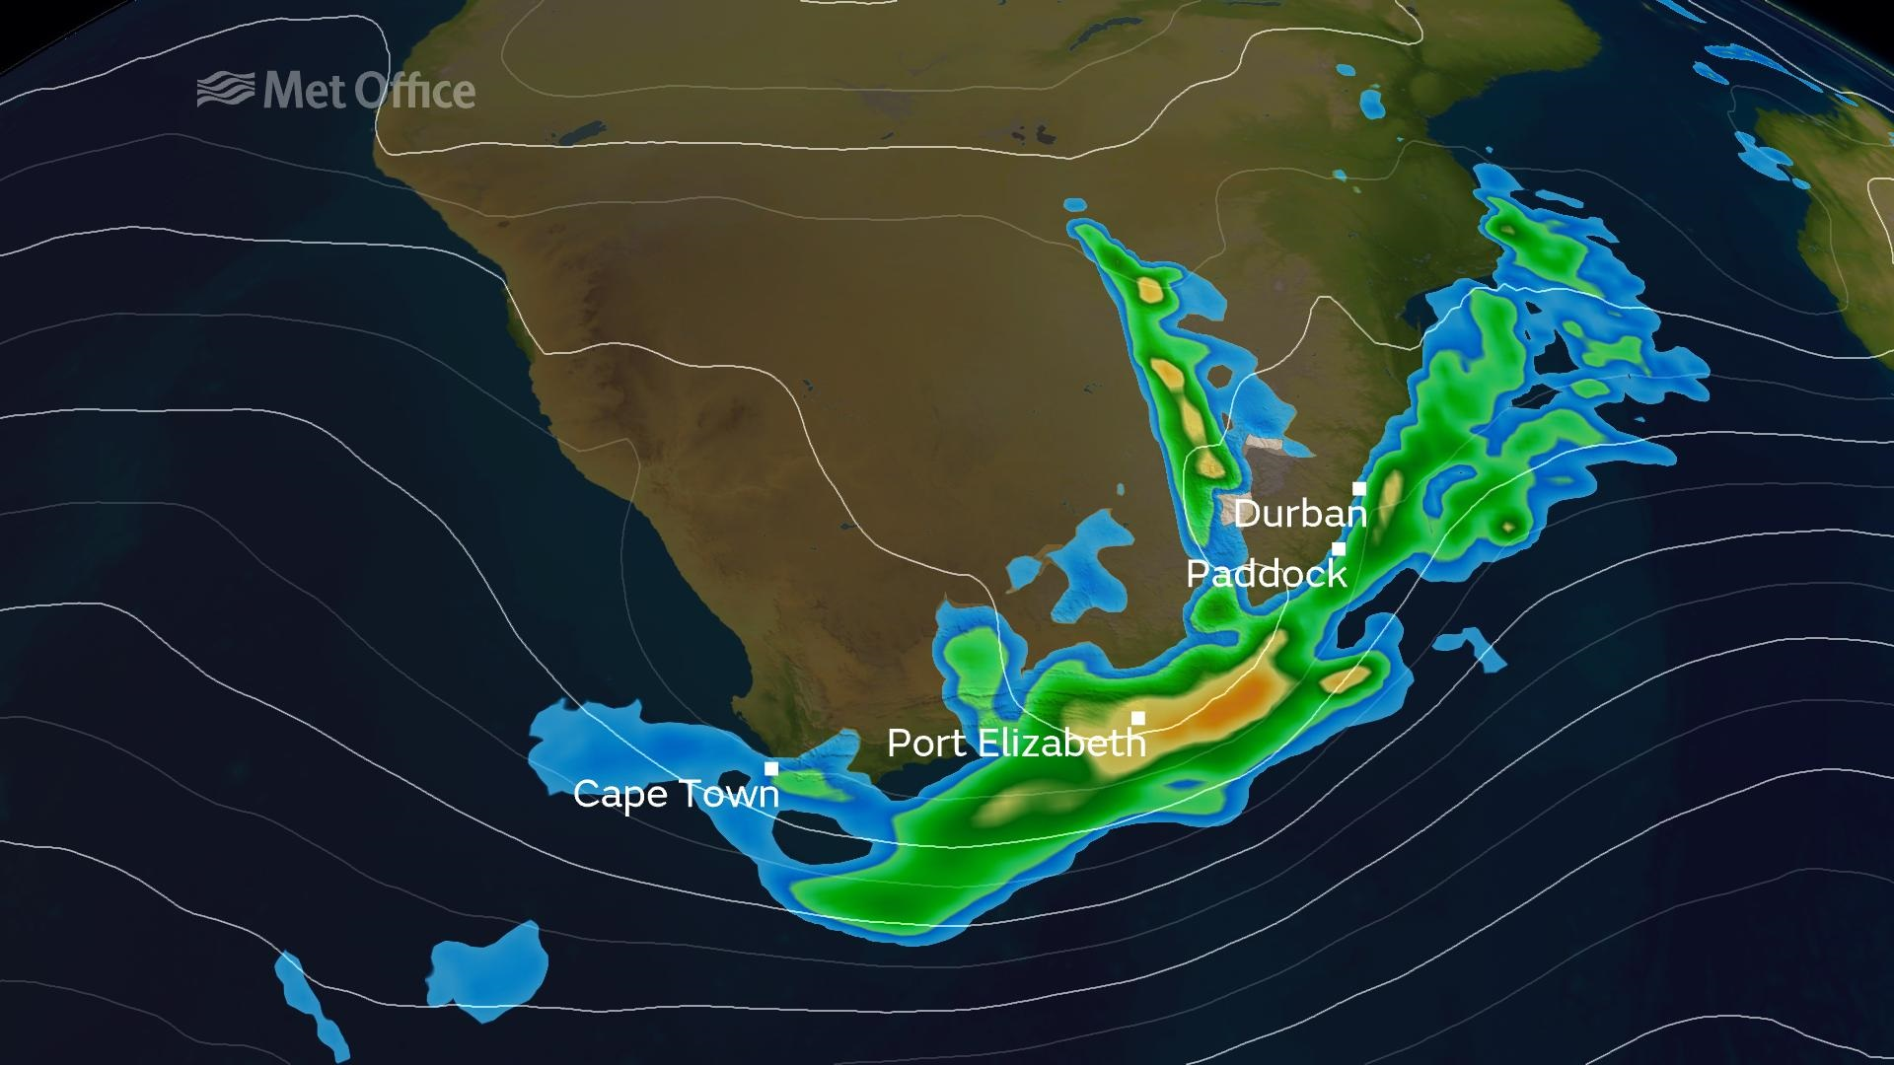
THANK
YOU

